Slide 1

Cyber Security Infrastructure
Shuronjit Biswas Sumon
Cyber Security Specialist
&
Pentester

Slide 2
Network security options and technologies
One of the network security options are protocol-based approaches which consist of implementing a network protocol that enables the distinction of virtual networks through techniques such as tagging or tunneling. The only requirement of this kind of approach is that physical devices (or a subset of them) support the selected protocol.
Furthermore, Machine virtualization-based approaches which consist of creating virtual networks by means of groups of interconnected virtual machines. Virtual machine monitors are used to instantiate virtual routers, and virtual links are established between them, regardless of physical network topology.
Two options for network security and two security technologies.
i. a. Anti-bot protection
b. Application access control
ii. a. Firewalling
b. Intrusion detection/intrusion prevention

Slide 3
data types to be protected, security levels required and secure boundary requirements
Data types to be protected
Customer database stored on system, however, no bank details stored.
Accounting system - Xero
Files associated with graphic design to Security levels required
Set for one user as a single business owner to Secure boundary requirements
Must control input and outputs of digital estate.
Further, describe the mission-critical network servers that are part of the infrastructure, through service provider i.e. Xero and Onedrive

Slide 4
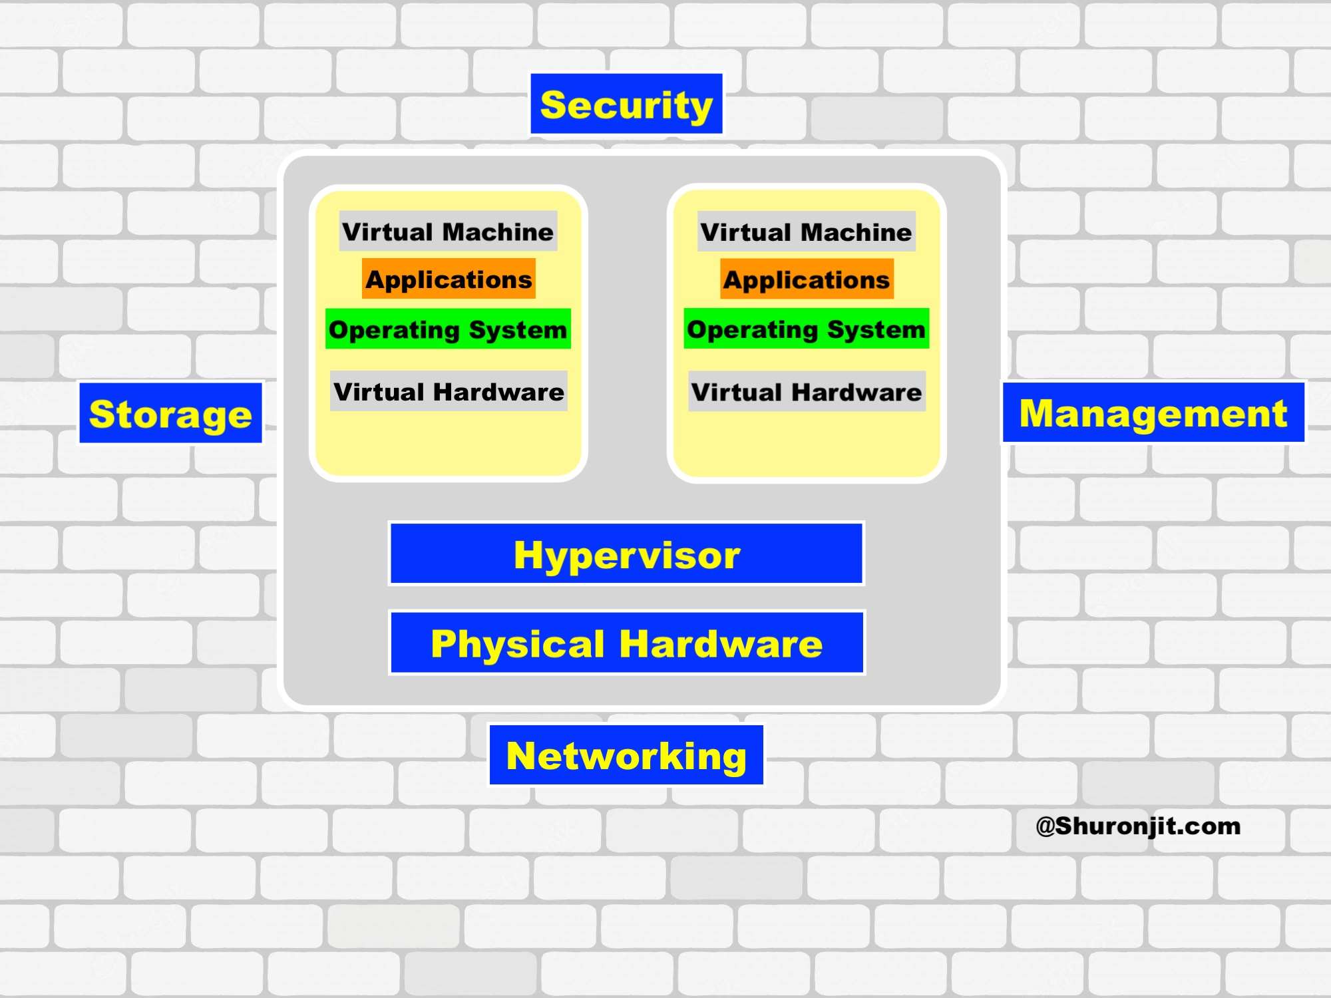
Infrastructure design

Slide 5
Implementation plan
Action | Responsibilities | Timelines
Basic design proposal | IT Project Manager | Day 5
feedback and modification | IT Project Manager | Day 8
Final design | IT Project Manager | Week 2
Implement virtualisation | IT Project Manager, IT Technical staff | Day 19
Testing | IT Project Manager, IT Technical staff | Day 26
Finalise and report | IT Project Manager | Day 30

Slide 6
Network security monitoring strategy
There are several methods to group various sorts of cyber security monitoring, such as by taking into consideration:
1. In-line monitoring (e.g. looking at traffic passing through a firewall)
2. Not in line monitoring, which includes:
* Analyzing Information about activity based intrusion detection
* Employing heuristic-based rules
* Taking the Big data approach
Most respondents to the project survey said that their cyber security monitoring process covered their:
* Network perimeter
* Endpoints (e.g. PCs and laptops)
* Core devices and systems (internal)

Slide 7
Tools
I will use a virtualization tool to implement the infrastructure. The common ones in the market are parallel. I will request access to client to continue to work on the implementation. The data will require will be based on clients infrastructure.

Slide 8

Thank You

